Slide 1

ICH and sustainable development
IMP 5.9
UNESCO
Intangible Cultural Heritage Section

Slide 2
In this presentation...
What the Convention says
Sustainable ICH
ICH supporting development
ICH supporting communities, generating income
Mitigation of risks
Case studies

Slide 3
What the Convention and its ODs say

Slide 4
The definition of ICH
Article 2.1
Living heritage, constantly changing
Recreated by communities and groups in response to their environment
Providing communities and groups with a sense of identity and continuity
Compatible with sustainable development

Slide 5
Sustainable development, sustainable ICH
“Development that meets the needs of the present without compromising the ability of future generations to meet their own needs.”
Sustaining intangible heritage means ensuring that it continues to be practiced today without compromising the ability of later generations to enjoy it in the future.

Slide 6
Sustainable development, a difficult balancing act in pursuit of a better future
In the framework of the Convention,
ICH contributes to:
Socio-cultural well-being
Good relations within and among communities
Economic prosperity
Environmental quality

Slide 7
ICH supporting development: Literacy through Poetry (Yemen)
Use of poetry in adult literacy classes in Yemen (2002-3)
Gave higher status to women’s oral poetry
Boosted literacy training for women
Empowered women in the public sphere

Slide 8
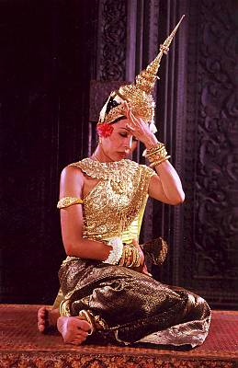
Supporting ICH by supporting performers: Royal Ballet of Cambodia
The Khmer court supported the Royal Ballet of Cambodia, also known as Khmer Classical Dance, for over 1000 years.
© Ministère de la Culture et des Beaux-Arts
Notes:
© Ministère de la Culture et des Beaux-Arts http://www.unesco.org/culture/ich/index.php?pg=00011&RL=00060

Slide 9
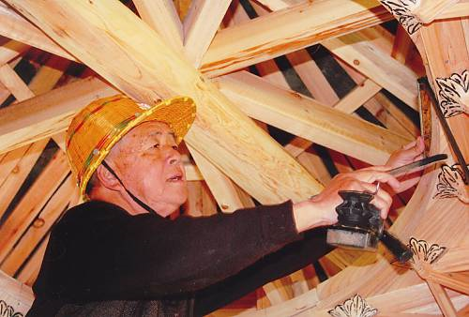

Paying for products and the transmission of skills: making wooden bridges (China)
Master builders working on Chinese wooden arch bridges are paid for their work
Above - (c) 2009 Daoju Zheng / Below - (c) 2009 by Difa Gong
Notes:
http://www.unesco.org/culture/ich/index.php?pg=00011&USL=00303

Slide 10
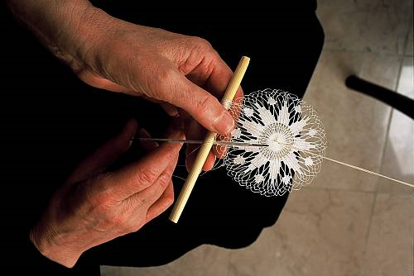
Paying for products: Croatian lace
Croatian lace has long been sold by rural women as a source of additional income.
Making lace (c) 2008 Croatian Ministry of Culture
Notes:
http://www.unesco.org/culture/ich/index.php?lg=en&pg=00011&RL=00245

Slide 11
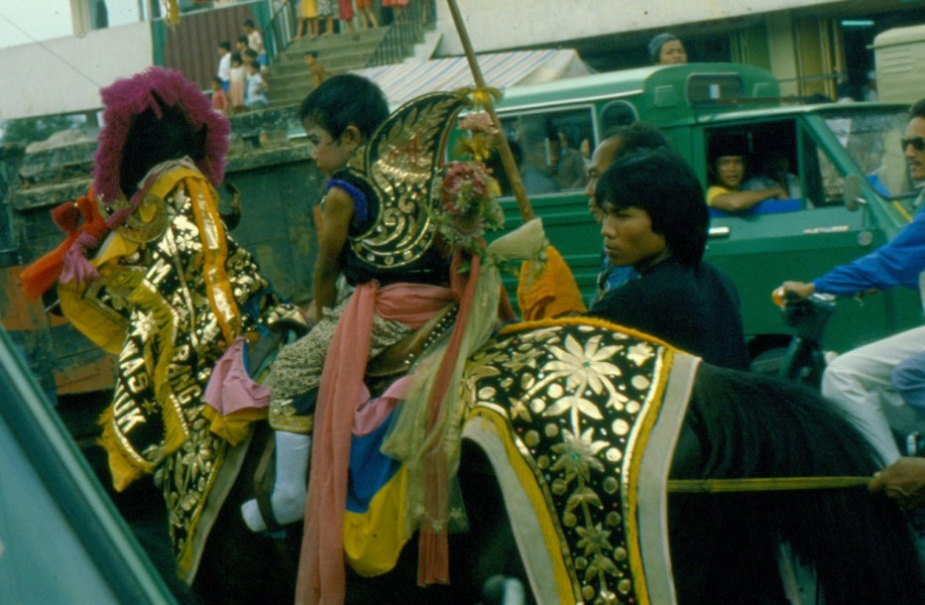
Paying for performances: Bandung procession (Indonesia)
Boy on horseback in the procession, dressed up and 'king for one day’ before his circumcision
(c) Wim van Zanten, 1981
Notes:
Boy on horseback in the procession, dressed up and 'king for one day’ before his circumcision (c) Wim van Zanten, 1981 – permission to use for this workshop

Slide 12
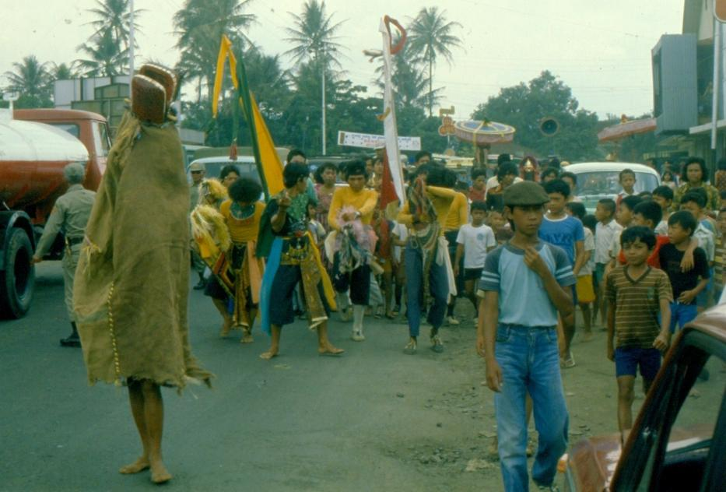
Bandung procession: dancers
Bandung procession with hobbyhorse dancers and horse mask (c) Wim van Zanten, 1981
Notes:
Bandung procession with hobbyhorse dancers and horse mask (c) Wim van Zanten, 1981

Slide 13
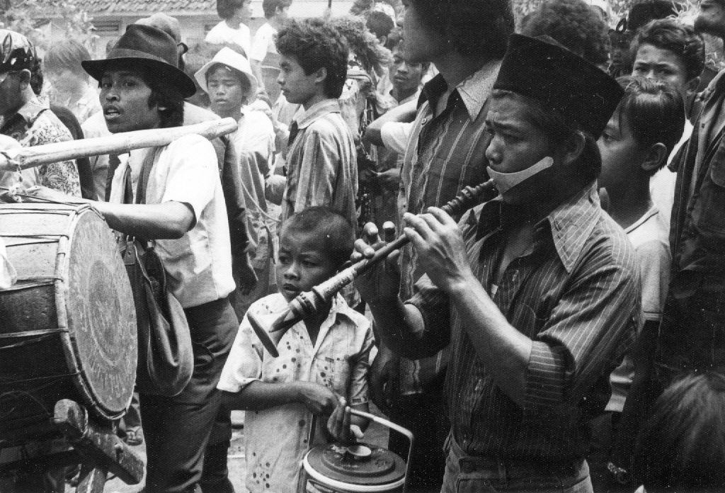
Bandung procession: musicians
Musicians playing shawm and drums in Bandung procession
(c) Wim van Zanten, 1981
Notes:
Musicians playing shawm and drums in Bandung procession
(c) Wim van Zanten, 1981 – permission to use for this workshop

Slide 14
Income-generation possibilities
Tourism
Using traditional knowledge for sustainably managing environmental resources for profit
Using traditional knowledge for new purposes or designs
Integrating traditional healing and pharmacopoeia into the national health system
Sale of handicraft products
Performing ICH expressions for payment
Festivals
Competitions
Business sponsorships

Slide 15
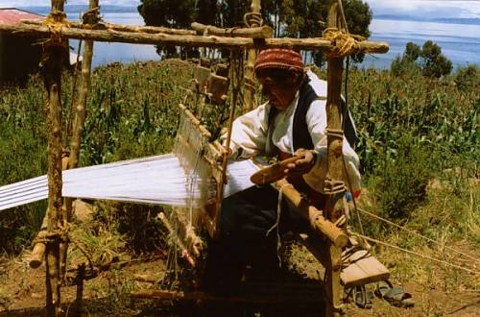
Taquile weaving case study (Peru): the importance of leaving communities in control
Taquile weaving in action
(c) Instituto Nacional de Cultura / Dante Villafuerte
Notes:
http://www.unesco.org/culture/ich/index.php?RL=00166

Slide 16
Risks
Freezing (no further development) (Article 2.1, OD 116)
Over-exploitation of natural resources (Article 2.1, OD 116)
Loss of function and meaning (OD 117)
Decontextualization (OD 102 (a))
Misrepresentation (OD 102 (b))
Misappropriation (OD 117)
Inequitable income distribution (OD 116)

Slide 17
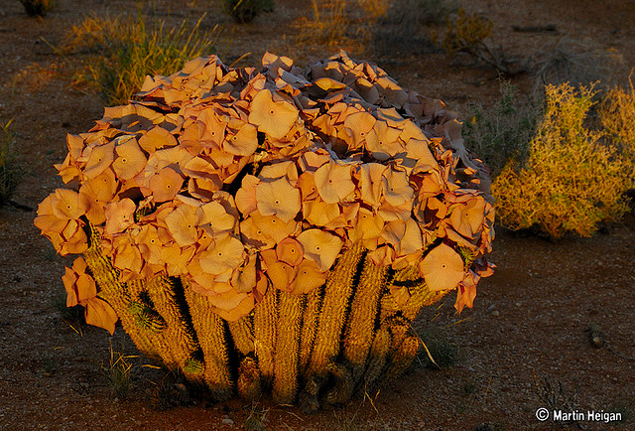
Commercializing traditional knowledge about Hoodia (Southern Africa): not a success story
The Hoodia gordonii plant
(c) Martin Heigan
Notes:
http://www.flickr.com/photos/martin_heigan/4281864681/sizes/z/in/photostream/

Slide 18
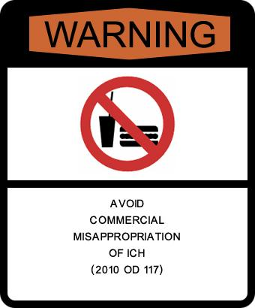
Avoid over-commercialization and unsustainable tourism (OD 102)

Slide 19
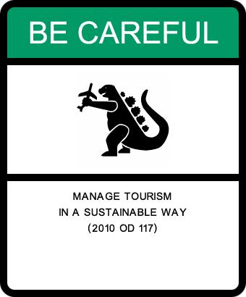
Commercial activities ... and trade should not ... threaten the viability of the ICH (OD 116)

Slide 20
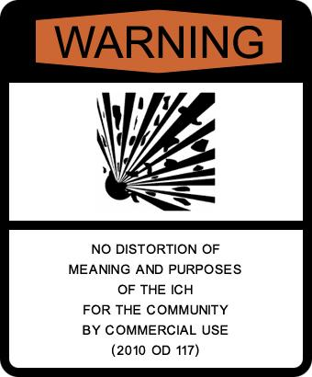
Avoid distortion of meaning and purpose of ICH to communities concerned (OD 117)

Slide 21
Mitigating risks through ...
Community participation and consent (Article 15)
Capacity building (OD 82)
Consultative mechanisms (OD 80)
Risk assessment, monitoring and evaluation (OD 105(c), 109)
Legal frameworks to protect community rights (OD 104)

Slide 22
Protecting IP rights
WIPO is investigating the protection of IP rights associated with ICH at the international level
Community -held IP rights associated with their ICH can be protected through national legislation

Slide 23
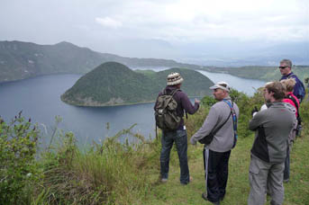
Runa Tupari case study (Ecuador)
In this example, ICH generates employment that in turn sustains the ICH
Tourists viewing a site on one of the Runa Tupari trails:
http://www.hosteltrail.com/runatupari/
Notes:
http://www.hosteltrail.com/runatupari/
Need to ask permission to use this photo

Slide 24
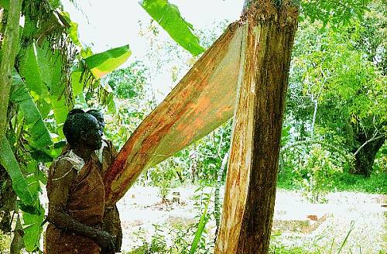
Uganda bark cloth case study: new applications of traditional skills
Removing the bark for the manufacture of bark cloth (c) JK Walusimbi
Notes:
http://www.unesco.org/culture/ich/index.php?lg=en&pg=00011&RL=00139

